Slide 1
From Zero to Hero: Accidental SQL Server DBAs Survival Guide
Gethyn ellis

Slide 2









Thank You! Sponsors

Slide 3
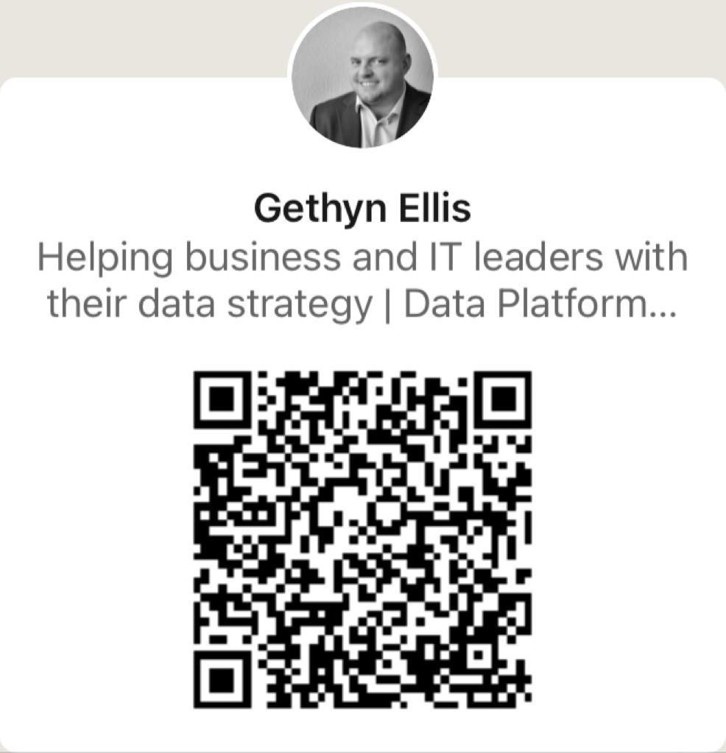
Poll

Slide 4


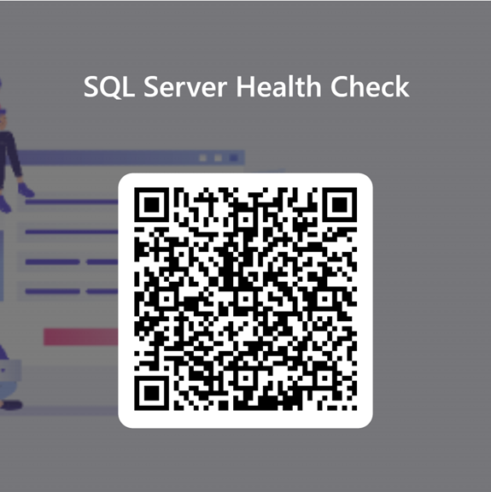

About me
Gethyn Ellis
Microsoft, Azure, Power Platform Trainer
www.gethynellis.com
gethyn@gethynellis.com
Twitter: @gethyn_ellis
LinkedIn: https://www.linkedin.com/in/gethynellis/

Slide 5
What we will cover
In this session we will talk about
What does a DBA do anyway?
Security
Recoverability
Reliability
Performance
Monitoring and Maintenance

Slide 6

Berry Wand – Accidental DBA

Slide 7

SQL Server is causing a headache

Slide 8

Time Management and Multitasking

Slide 9

Limited Expertise and Knowledge

Slide 10

Data Security and Compliance

Slide 11

Disaster Recovery Planning

Slide 12

What is a DBA?

Slide 13

Berry doesn’t have a DBA

Slide 14



The easy answer
Call us

Slide 15
Here’s a plan
DBA Tools
Security
Recoverability
Maintenance
Monitoring
Performance

Slide 16

Demo

Slide 17

Run SP_Blitz

Slide 18

At least you’ll have some backups that work

Slide 19

What Berry Did
She followed the steps here
That worked fine most of the time
She bought 10 call off support days from me. Other providers are available
She quickly realised that it was better to have a virtual DBA – so she called me back
Data now drives Berry’s business. Berry doesn’t have to worry about the data being available

Slide 20
What we covered
In this session we will talked about
What does a DBA do anyway?
Architecure/Design
Configuration and setup
Security
Recoverability
Reliability
Performance
Monitoring and Maintenance

Slide 21

Questions Discussion

